Slide 1

Feuerzangenbowle
Physics of Imbibition and Porous Media Flow
Manuel Lippert
Physik (Master of Science)

Slide 2


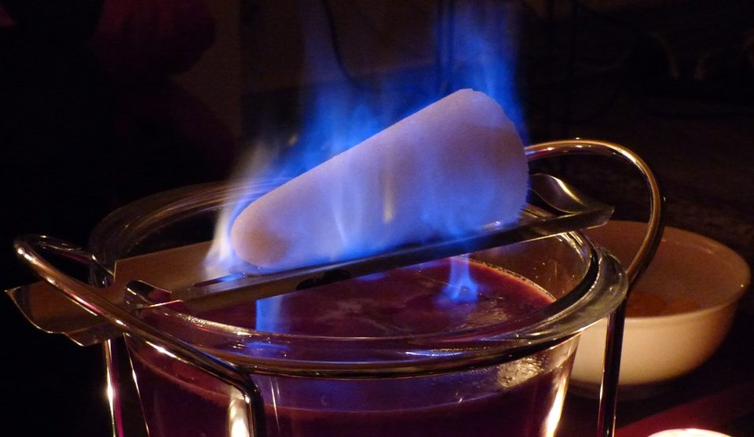
WHAT IS IMBIBITION?
1
Motivation
Notes:
------------------------------------------------------------------------------------------------------------------
MOTIVATION - WHAT IS IMBIBITION?
- Imbibition process of everyday life
- Dunking biscuit into coffee, getting drenched with rain, drenching sugar with alcohol
- Application in nature
-> Water reaching tips of the tallest trees
-> Flow through soil (Dracy Law)
-Application in industry
-> Oil recovery
-> Chromatography (experiment in chemistry)
-> Food processing, agriculture
- Interplay of capillary pressure, viscous drag, volume conservation and gravity
- Evolution of invasion with universial scaling on large length and timescales
-> Independent of the microscopic details of the fluid and media
- In the following discussion about the Lucas Washburn Law and the influence of geometry

Slide 3
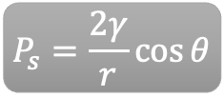
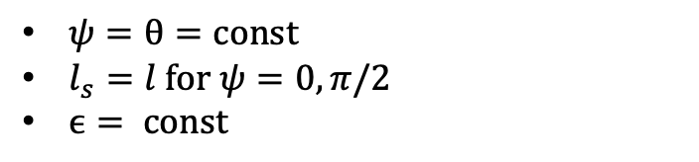
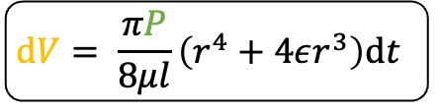
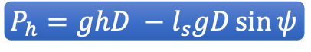

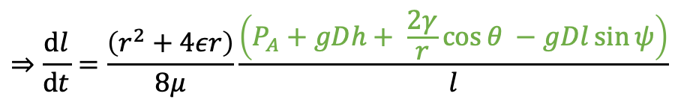

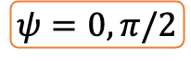

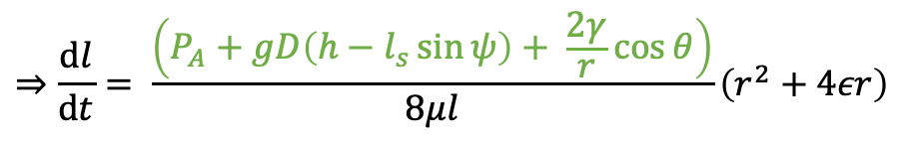
IMBIBITION AND DYNAMICS OF CAPILLARY FLOW
2
Theory
E. W. Washburn (1921) “The dynamics of capillary flow“
$$P_{h}=ghD −l_{s}gD\sin{ψ}$$
$$P_{s}=\frac{2γ}{r}\cos{θ}$$
$$P_{A}=\text{const}$$
$$P=P_{A}+P_{h}+P_{s}$$
$$\text{d}V= \frac{πP}{8μl}\left(r^{4}+4εr^{3}\right)\text{d}t$$
Poiseuille‘s Law
$$\text{d}V=πr^{2}\text{d}l$$
$ψ=θ=\text{const}$
$l_{s}=l \text{for} ψ=0,π/2$
$ϵ= \text{const}$
$$⇒\frac{\text{d}l}{\text{d}t}= \frac{\left(P_{A}+gD\left(h−l_{s}\sin{ψ}\right)+ \frac{2γ}{r}\cos{θ}\right)}{8μl}\left(r^{2}+4εr\right)$$
$$⇒\frac{\text{d}l}{\text{d}t}=\frac{\left(r^{2}+4εr\right)}{8μ}\frac{\left(P_{A}+gDh+ \frac{2γ}{r}\cos{θ −gDl\sin{ψ}}\right)}{l}$$
$$ψ=0, π/2$$
Notes:
------------------------------------------------------------------------------------------------------------------
THEORY - CAPILLARY FLOW
- This section about the Lucas-Washburn Law also known as BCLW Imbibition
-> BC = Bell, Cameron (1906) find relation between length and time experimentally
-> L = Lucas (1918) find coeffient of the relation
-> W = Washburn (1921) theoretical derivation
-> Concentrate on the derivation
- Explain geometry
-> Single capillary with uniform circular cross-section r (any length and shape)
-> Contact with the liquid at point A in depth
-> End B open to atmosphere or closed and evacuated
- After time t_0 and lenght l_0 velocity dropped to a value that follows the Poiseulli's Law
- Poiseulli's Law will from there on persist
- For small capillary only the Poiseulli's regime from concern
- Poiseulli's Law (epsilon is coeffient of the slip, l length of column liquid) should be known
- After time t the meniscus will arrived at point M with velocity (dl/dt)
- Capillary cylindrical shape -> dV
- Pressure given by
-> P_A atmospheric pressure (const),
-> P_h hydrostatic pressure (ls and psi) and
-> P_s capillary pressure (contact angle theta and surface tension)
- Assumption pis, theta, eps const
- Limiting only to cases with psi = 0, pi/2 -> ls = l
- Rearrangement

Slide 4
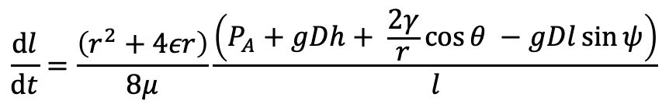
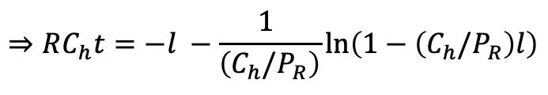
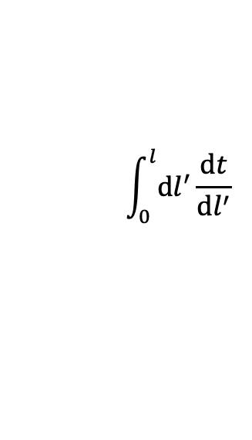
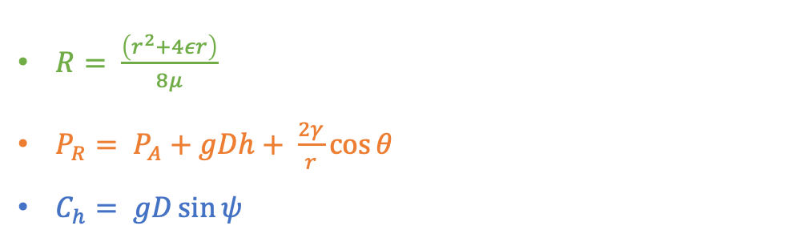
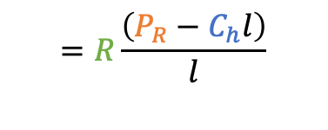
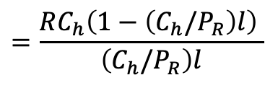
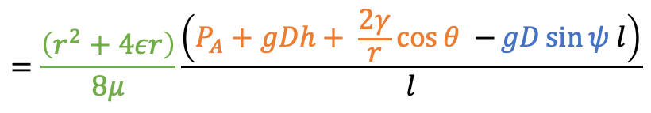
IMBIBITION AND DYNAMICS OF CAPILLARY FLOW
2
Theory
E. W. Washburn (1921) “The dynamics of capillary flow“
$$\frac{\text{d}l}{\text{d}t}=\frac{\left(r^{2}+4εr\right)}{8μ}\frac{\left(P_{A}+gDh+ \frac{2γ}{r}\cos{θ −gDl\sin{ψ}}\right)}{l}$$
$$=\frac{\left(r^{2}+4εr\right)}{8μ}\frac{\left(P_{A}+gDh+ \frac{2γ}{r}\cos{θ −}gD\sin{ψ l}\right)}{l}$$
$$=R\frac{\left(P_{R}−C_{h}l\right)}{l}$$
$$=\frac{RC_{h}\left(1−\left(C_{h}/P_{R}\right)l\right) }{\left(C_{h}/P_{R}\right)l}$$
$ψ=θ=\text{const}$
$l_{s}=l \text{for} ψ=0,π/2$
$ϵ= \text{const}$
$$\int_{0}^{l}{\text{d}l^{′}}\frac{\text{d}t}{\text{d}l^{′}}$$
$$⇒RC_{h}t=−l −\frac{1 }{\left(C_{h}/P_{R}\right)}\text{ln}\left(1−\left(C_{h}/P_{R}\right)l\right)$$
$R= \frac{\left(r^{2}+4εr\right)}{8μ}$
${P_{R}= P}_{A}+gDh+ \frac{2γ}{r}\cos{θ }$
$C_{h}= gD\sin{ψ }$
Notes:
------------------------------------------------------------------------------------------------------------------
THEORY - CAPILLARY FLOW
- Simplificate with R, P_R and C_h
- Integrate inverse of quotient dl/dt

Slide 5
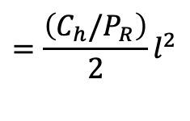
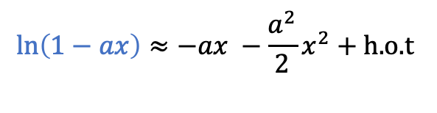
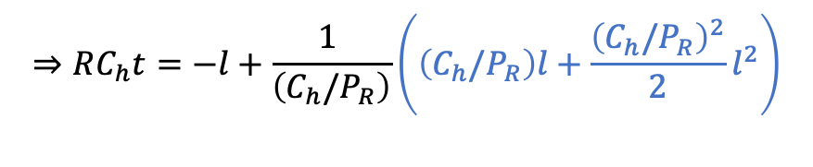
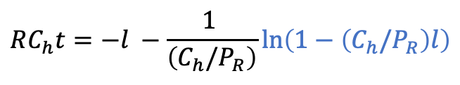
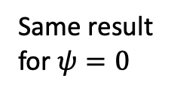
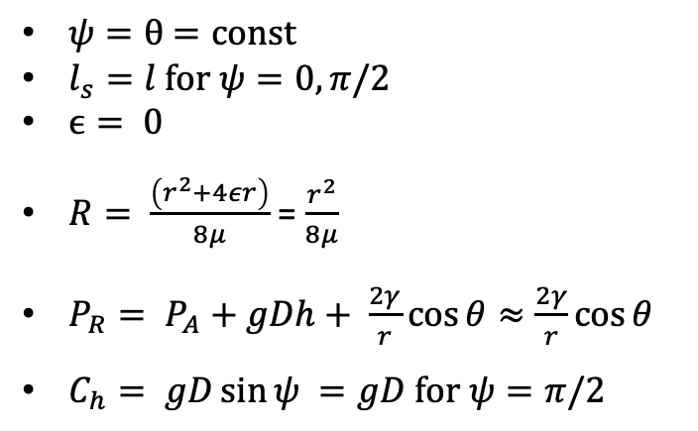
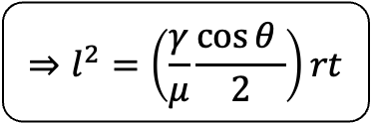
IMBIBITION AND DYNAMICS OF CAPILLARY FLOW
2
Theory
E. W. Washburn (1921) “The dynamics of capillary flow“
$$RC_{h}t=−l −\frac{1 }{\left(C_{h}/P_{R}\right)}\text{ln}\left(1−\left(C_{h}/P_{R}\right)l\right)$$
$$\text{ln}\left(1−ax\right)≈−ax −\frac{a^{2}}{2}x^{2}+\text{h}\text{.}\text{o}\text{.}\text{t}$$
$$⇒RC_{h}t=−l+\frac{1 }{\left(C_{h}/P_{R}\right)}\left(\left(C_{h}/P_{R}\right)l+\frac{{\left(C_{h}/P_{R}\right)}^{2}}{2}l^{2}\right)$$
$ψ=θ$ $=\text{const}$
$l_{s}=l \text{for} ψ=0,π/2$
$ϵ= \text{0}$
$R= \frac{\left(r^{2}+4εr\right)}{8μ}$ = $\frac{r^{2}}{8μ}$
${P_{R}= P}_{A}+gDh+ \frac{2γ}{r}\cos{θ≈\frac{2γ}{r}\cos{θ }}$
$C_{h}= gD\sin{ψ }=gD \text{for} ψ=π/2$
$$=\frac{\left(C_{h}/P_{R}\right)}{2}l^{2}$$
$$⇒l^{2}=\left(\frac{γ}{μ}\frac{\cos{θ }}{2}\right)rt$$
Same result for $ψ=0$
„Lucas-Washburn Law“
Notes:
------------------------------------------------------------------------------------------------------------------
THEORY - CAPILLARY FLOW
- Look at psi = pi/2 and assumptions
-> psi = pi/2, C_h with new value
-> eps = 0 (true for liquids which wets the capillary) R with new value
-> liquid moves under its own capillary pressure P_R = P_s
- Expansion of logarithmic term (C_h l << P_R)
- Rearrangement -> Lucas-Washburn Law
- Same result for psi = 0

Slide 6
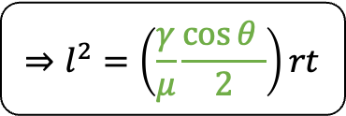
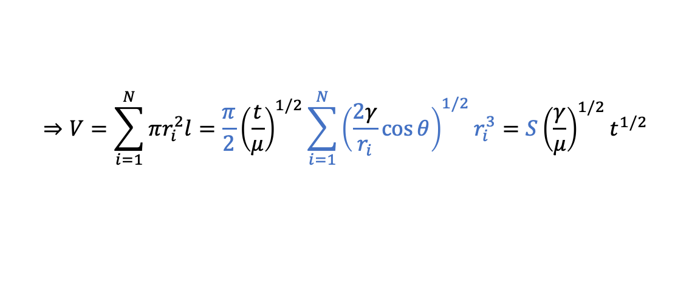
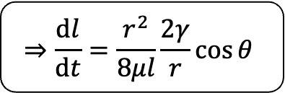
IMBIBITION AND DYNAMICS OF CAPILLARY FLOW
2
Theory
E. W. Washburn (1921) “The dynamics of capillary flow“
Penetrativity
$$⇒l^{2}=\left(\frac{γ}{μ}\frac{\cos{θ }}{2}\right)rt$$
„Lucas-Washburn Law“
$$⇒\frac{\text{d}l}{\text{d}t}=\frac{r^{2}}{8μl}\frac{2γ}{r}\cos{θ }$$
Rate of Penetration
$$⇒V=\sum_{i=1}^{N}{πr_{i}^{2}l=\frac{π}{2}{\left(\frac{t}{μ}\right)}^{1/2}}\sum_{i=1}^{N}{{\left(\frac{2γ}{r_{i}}\cos{θ}\right)}^{1/2}r_{i}^{3}=S{\left(\frac{γ}{μ}\right)}^{1/2}t^{1/2}}$$
Notes:
------------------------------------------------------------------------------------------------------------------
THEORY - CAPILLARY FLOW
- Factor is called penetrativity (proportionalities)
- Rate of penetration (proportionalities)
- Amount of Liquid entered in porous media
-> Small capillaries with different radius but small enough
-> Volume equation

Slide 7
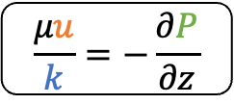


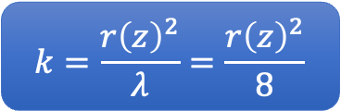
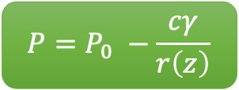
IMBIBITION IN GEOMETRIES WITH AXIAL VARIATIONS IN 3D
2
M. Reyssat, L. Courbin, E. Reyssat, and H. A. Stone (2008) “Imbibition in geometries with axial variations”
Theory
$$P=P_{0} −\frac{cγ}{r\left(z\right)}$$
Volumetric Flow Rate
$$Q=uπr{\left(z\right)}^{2}$$
$$\frac{μu}{k}=−\frac{∂P}{∂z}$$
Darcy Law
$$k=\frac{r{\left(z\right)}^{2}}{λ}=\frac{r{\left(z\right)}^{2}}{8}$$
Permeability
$$⇒\frac{8μQ}{πr{\left(z\right)}^{4}}=−\frac{∂P}{∂z}$$
Notes:
------------------------------------------------------------------------------------------------------------------
THEORY - GEOMETRY
- Based on Reyssat and only concentrate on the 3D case
- One-Dimensional flow in z-Direction
- Using classical Darcy description with Darcy Law (Experimental Law from Henry Darcy)
-> averaged velocity u
-> permeability k (ability of material to transmit fluid) depending on shape of the cross-section
- From Mass conservation follows Volumetric Flow Q
- Pressure P_0 with (P_A and P_h) and P_s with c parameter depending local geometry and contact angle theta

Slide 8
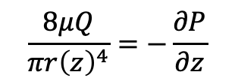
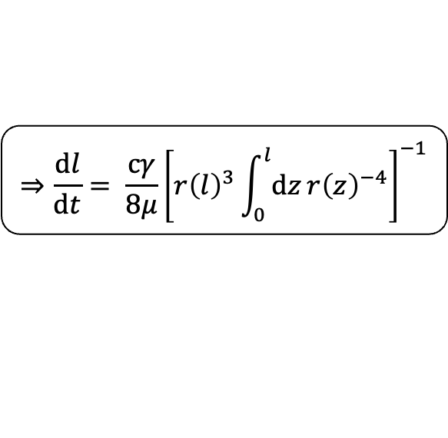
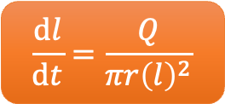
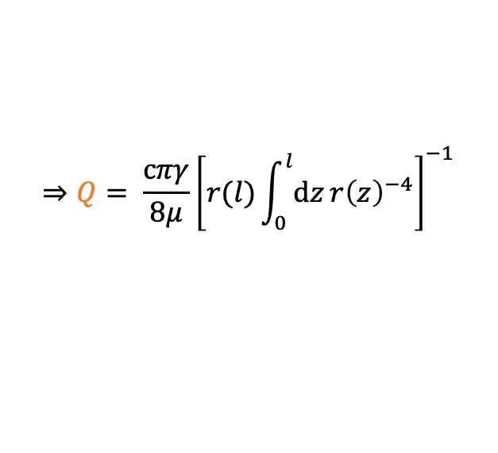
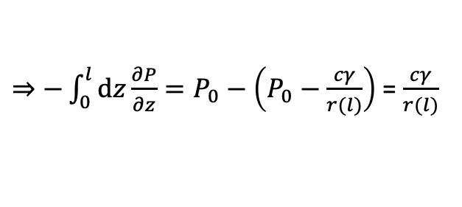
IMBIBITION IN GEOMETRIES WITH AXIAL VARIATIONS IN 3D
2
M. Reyssat, L. Courbin, E. Reyssat, and H. A. Stone (2008) “Imbibition in geometries with axial variations”
Theory
$$\frac{8μQ}{πr{\left(z\right)}^{4}}=−\frac{∂P}{∂z}$$
$⇒−\int_{0}^{l}{\text{d}z}\frac{∂P}{∂z}=P_{0}−\left(P_{0}−\frac{cγ}{r(l)}\right)$ = $\frac{cγ}{r(l)}$
$$\frac{\text{d}l}{\text{d}t}=\frac{Q}{πr{\left(l\right)}^{2}}$$
$$⇒Q= \frac{cπγ}{8μ}{\left[r(l)\int_{0}^{l}{\text{d}z}r{\left(z\right)}^{−4}\right]}^{−1}$$
$$⇒\frac{\text{d}l}{\text{d}t}= \frac{cγ}{8μ}{\left[r{\left(l\right)}^{3}\int_{0}^{l}{\text{d}z}r{\left(z\right)}^{−4}\right]}^{−1}$$
General Imbibition Equation for Invasion into structured Solid in 3D
Notes:
------------------------------------------------------------------------------------------------------------------
THEORY - GEOMETRY
- Integrate from z = 0 (P = P_0) to z = l (P = P_0 - P_s) and Rearrangements
- Substitute Q with velocity of the meniscus at position l with known equation but on position l (r(l))
- General imbibition equation for invasion into structured solid in 3D

Slide 9
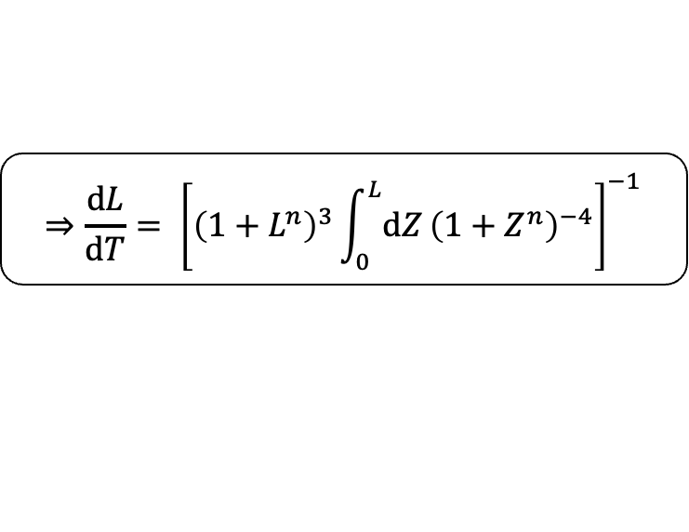
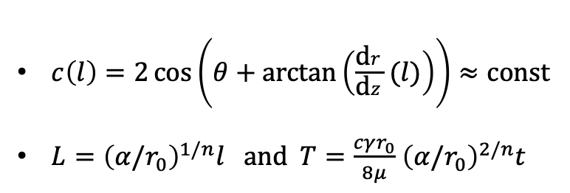
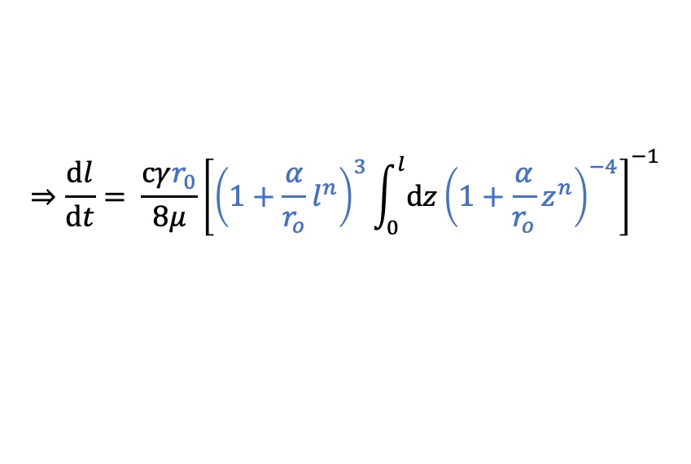

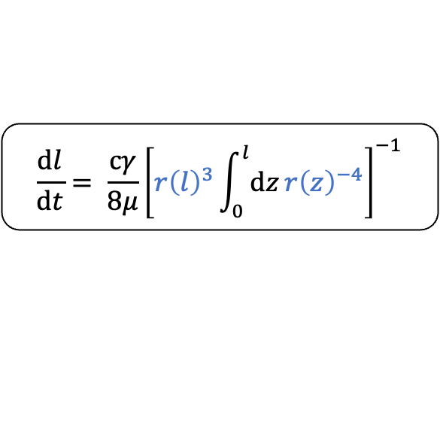
IMBIBITION IN GEOMETRIES WITH AXIAL VARIATIONS IN 3D
2
M. Reyssat, L. Courbin, E. Reyssat, and H. A. Stone (2008) “Imbibition in geometries with axial variations”
Theory
Power-Law shaped Structure
$$\frac{\text{d}l}{\text{d}t}= \frac{cγ}{8μ}{\left[r{\left(l\right)}^{3}\int_{0}^{l}{\text{d}z}r{\left(z\right)}^{−4}\right]}^{−1}$$
$$r\left(z\right)=r_{0}+αz^{n}$$
$$⇒\frac{\text{d}l}{\text{d}t}= \frac{cγr_{0}}{8μ}{\left[{\left(1+\frac{α}{r_{o}}l^{n}\right)}^{3}\int_{0}^{l}{\text{d}z}{\left(1+\frac{α}{r_{o}}z^{n}\right)}^{−4}\right]}^{−1}$$
$$⇒\frac{\text{d}L}{\text{d}T}= {\left[{\left(1+L^{n}\right)}^{3}\int_{0}^{L}{\text{d}Z}{\left(1+Z^{n}\right)}^{−4}\right]}^{−1}$$
$c\left(l\right)=2\cos\left(θ+\text{arctan}\left(\frac{\text{d}r}{\text{d}z}(l)\right)\right)≈\text{const}$
$L={\left(α/r_{0}\right)}^{1/n}l \text{and} T=\frac{cγr_{0}}{8μ}$ ${\left(α/r_{0}\right)}^{2/n}t$
Notes:
------------------------------------------------------------------------------------------------------------------
THEORY - GEOMETRY
- Use Power-Law to describe capillary structure
- Assume c(l) is approximately const since cosine is bounded
- Dimensionaless Parameter
- Dimensionaless Equation

Slide 10
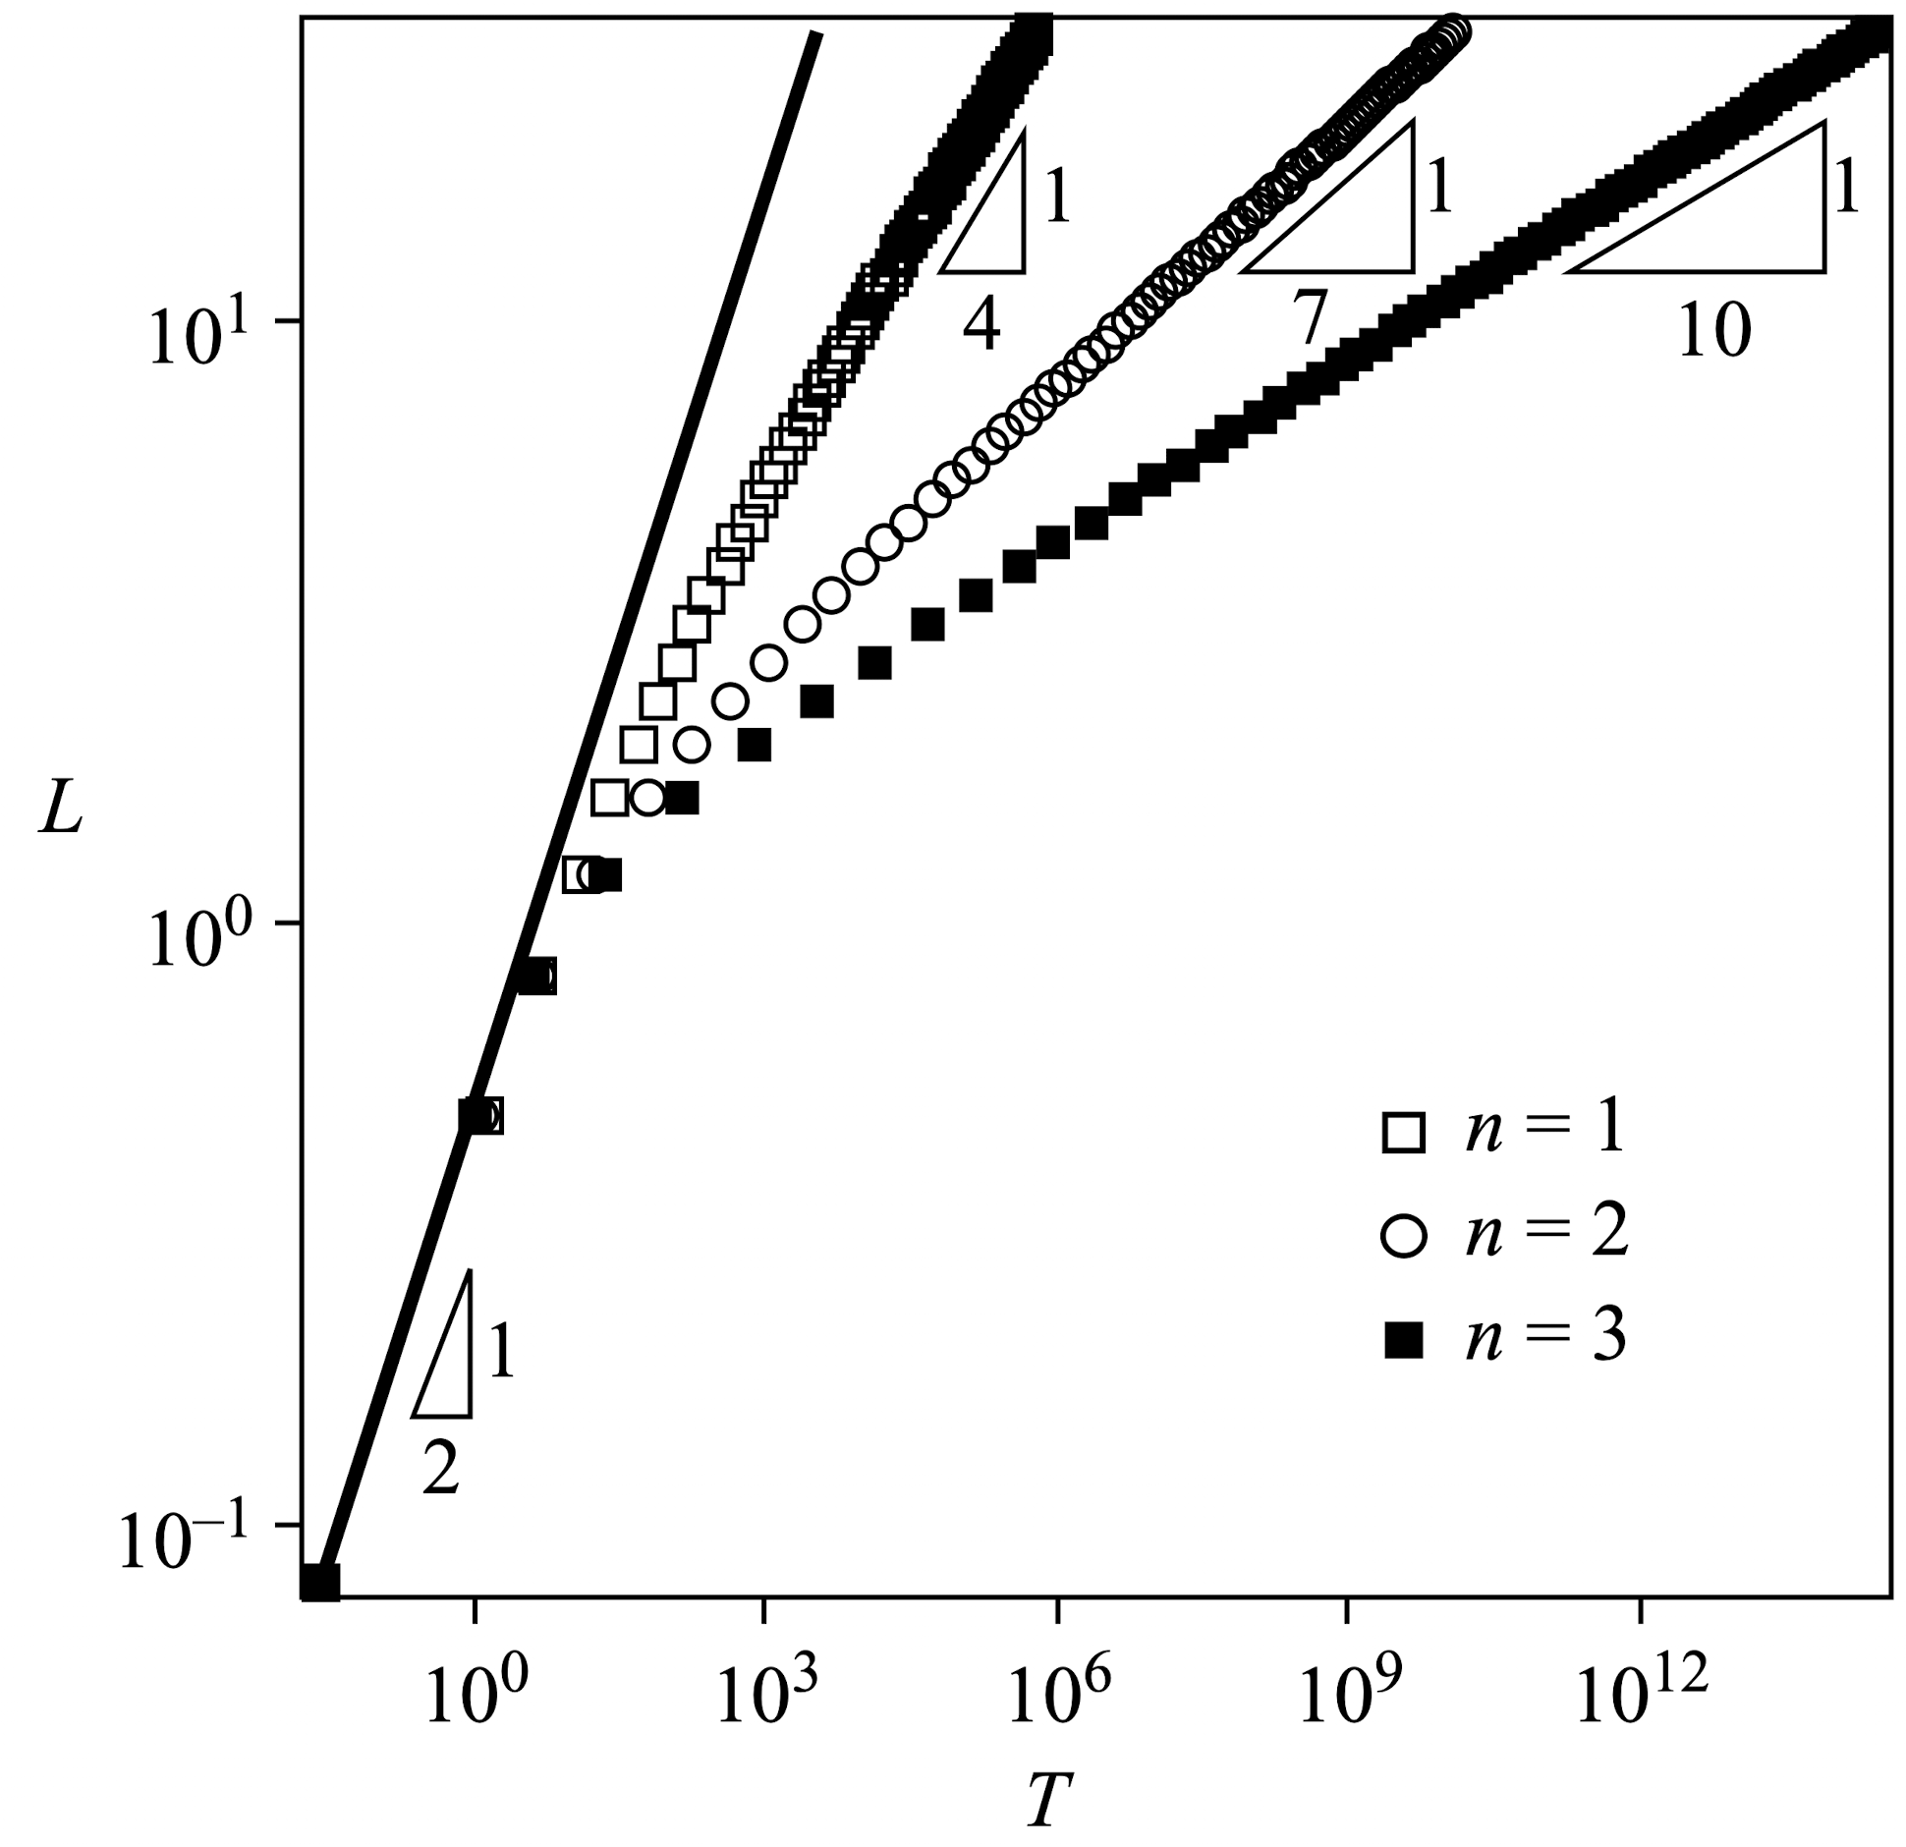
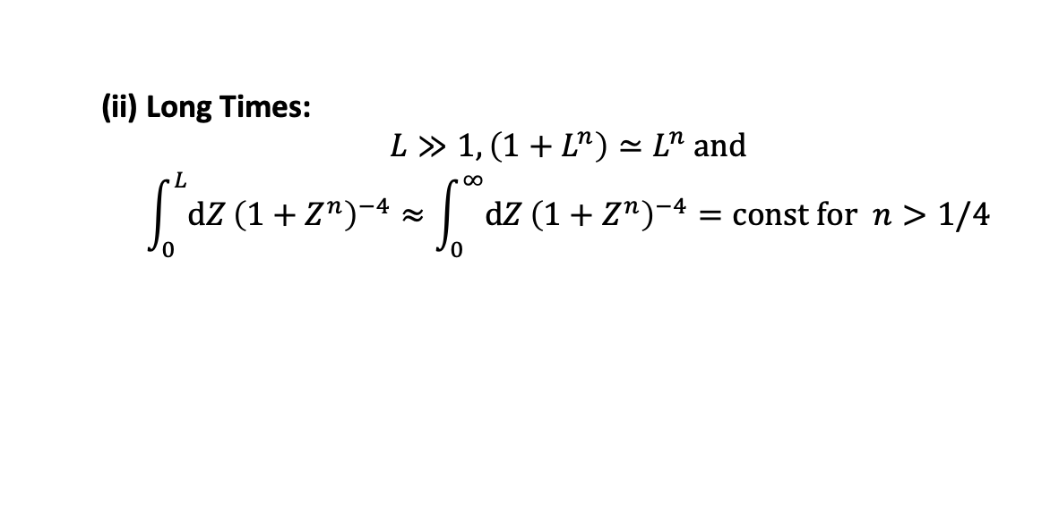
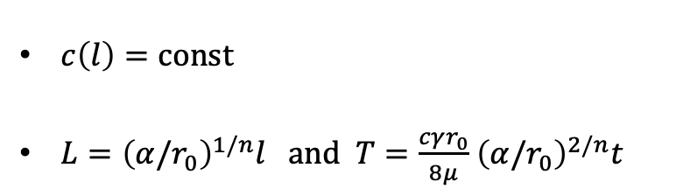
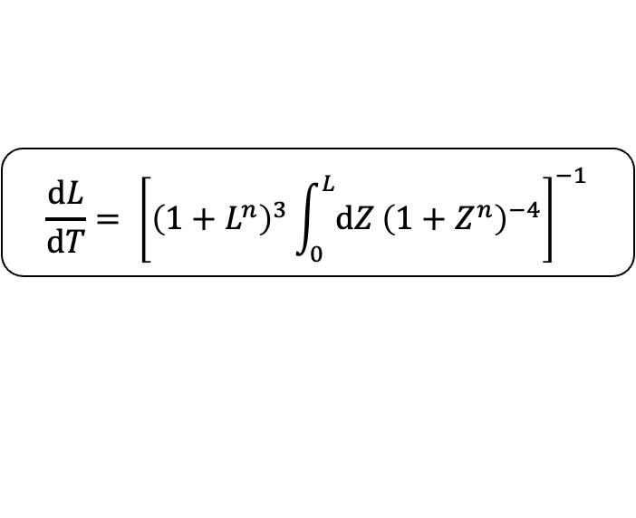
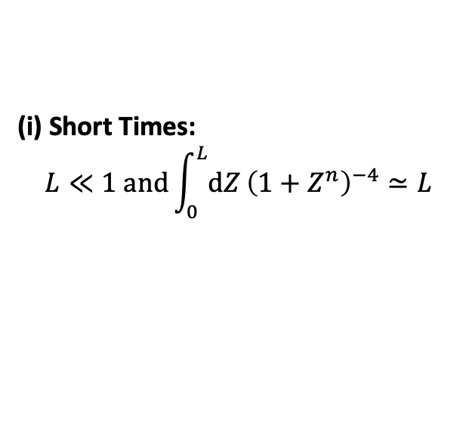
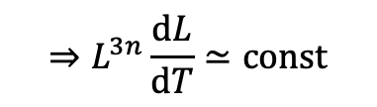
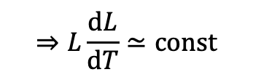
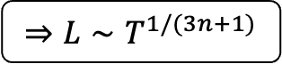
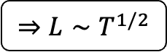
IMBIBITION IN GEOMETRIES WITH AXIAL VARIATIONS IN 3D
2
M. Reyssat, L. Courbin, E. Reyssat, and H. A. Stone (2008) “Imbibition in geometries with axial variations”
Theory
$$\frac{\text{d}L}{\text{d}T}= {\left[{\left(1+L^{n}\right)}^{3}\int_{0}^{L}{\text{d}Z}{\left(1+Z^{n}\right)}^{−4}\right]}^{−1}$$
(I) $n=0 \left(r\left(z\right)=r_{0}\right): ⇒L∼T^{1/2}$ „Lucas-Washburn Law“
(II) $n≥1:$
(i) Short Times:
$$L≪1 \text{and}\int_{0}^{L}{\text{d}Z}{\left(1+Z^{n}\right)}^{−4}≃L$$
$$⇒L\frac{\text{d}L}{\text{d}T}≃\text{const}$$
$$⇒L∼T^{1/2}$$
(ii) Long Times:
$$L≫1,\left(1+L^{n}\right)≃L^{n} \text{and}$$
$$\int_{0}^{L}{\text{d}Z}{\left(1+Z^{n}\right)}^{−4}≈\int_{0}^{∞}{\text{d}Z}{\left(1+Z^{n}\right)}^{−4}=\text{const} \text{for} n>1/4$$
$c\left(l\right)=\text{const}$
$L={\left(α/r_{0}\right)}^{1/n}l \text{and} T=\frac{cγr_{0}}{8μ}$ ${\left(α/r_{0}\right)}^{2/n}t$
$$⇒L^{3n}\frac{\text{d}L}{\text{d}T}≃\text{const}$$
$$⇒L∼T^{1/(3n+1)}$$
Notes:
------------------------------------------------------------------------------------------------------------------
THEORY - GEOMETRY
- Case n = 0 -> Lucas Washburn Law
- Case n >= 1
-> Short times L << 1 -> Bracket = 1, Integral = L
-> L ~T^1/2
-> Long times L >> 1 -> Bracket = L^n, Integral = Integral to infinity = const for n > 1/4
-> L ~T^1/(3n+1)
- Show Graphic of Solution
- Cross-Over between this two limits at L = 1
- Second regime depends on parameter n
-> The more diverging the geometry, the slower the dynamics become at long times

Slide 11
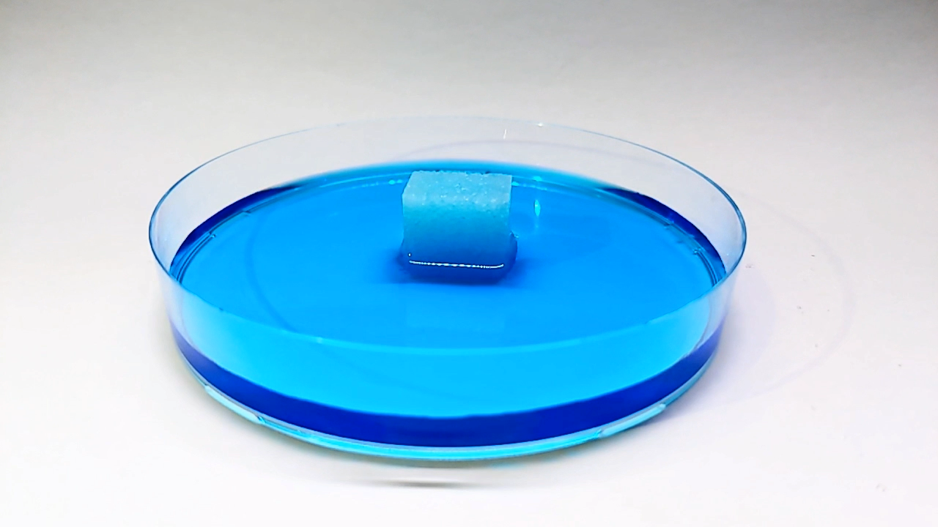
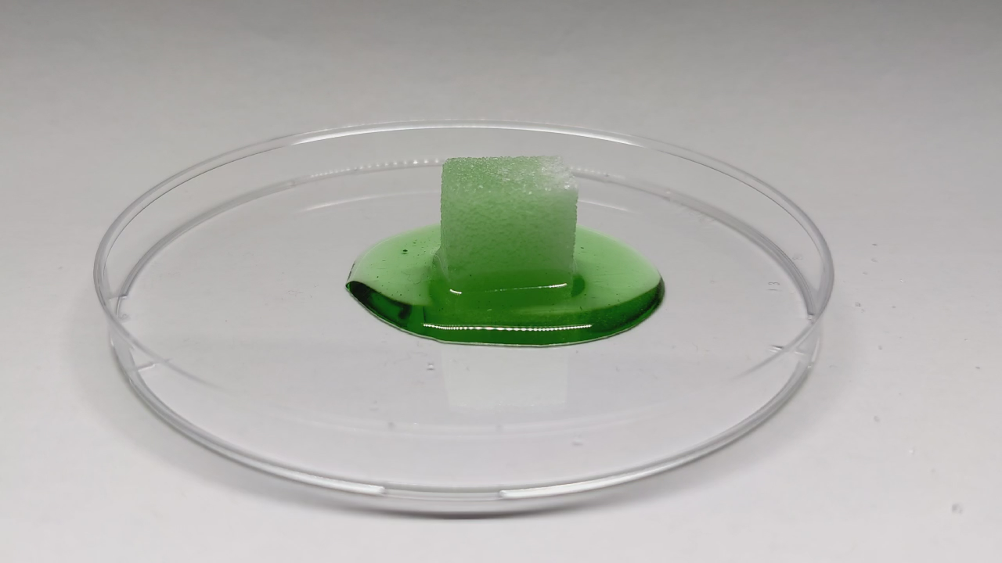
IMBIBITION WITH SUGAR IN WATER AND GLYCERIN
3
Experiments
Water
Glycerin
Slowed down with 1s = 0.125s
Sped up with 1s = 30s
Notes:
-----------------------------------------------------------------------------------------------------------------
EXPERIMENTS
- Experiments with sugar since the subject is the Feuerzangenbowle
-> Water (blue) video slowed down 1s = 0.125s
-> Glycerin (green, more viscous) video sped up 1s = 30s

Slide 12
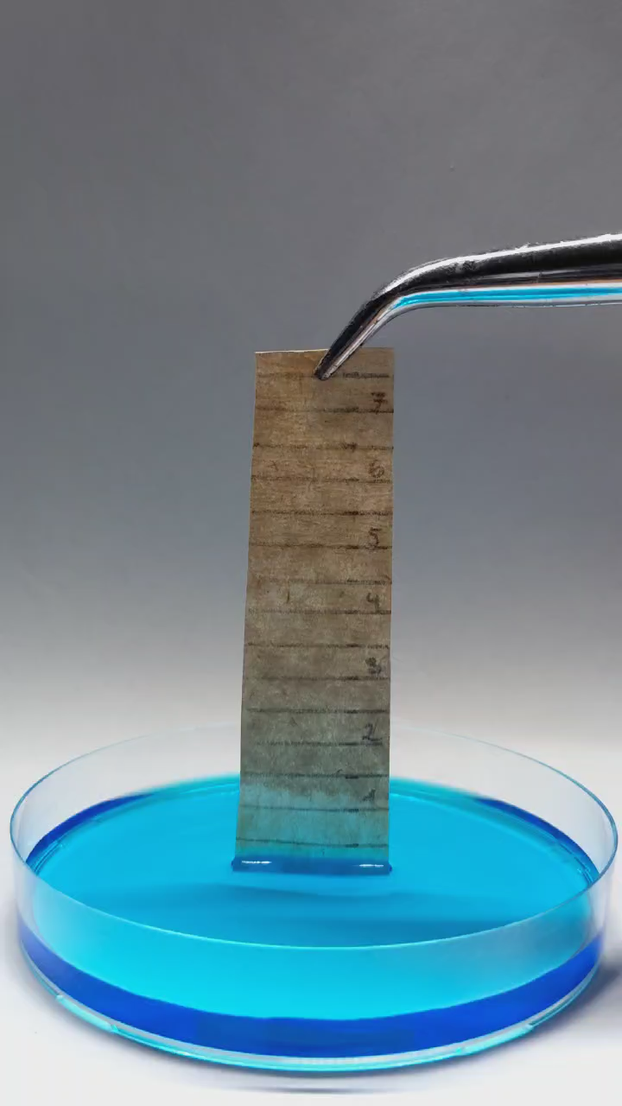
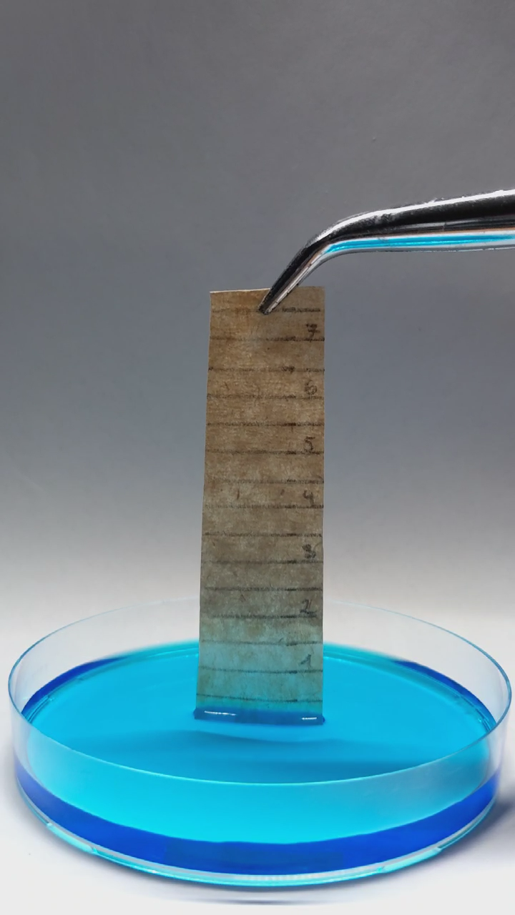










IMBIBITION WITH FILTER PAPER IN WATER
3
F. Dullien (1991) “Porous Media – Fluid Transport and Pore Structure”
Experiments
Sped up with 1s = 10s
$$l$$
$$t$$
Notes:
-----------------------------------------------------------------------------------------------------------------
EXPERIMENTS
- Experiment with filter paper (Inspiration from Dullien which was mentioned in Reyssat study)
-> Put coffee filter paper in contact with water
-> l = t^1/2 lit bit visible
-> Repeat experiment multiple times and get Lucas-Washburn Law (with substraction of offset (explain?))
- Life Experiment with big sugar cone (?)

Slide 13

IMBIBITION WITH FILTER PAPER IN WATER
3
F. Dullien (1991) “Porous Media – Fluid Transport and Pore Structure”
Experiments
Notes:
-----------------------------------------------------------------------------------------------------------------
EXPERIMENTS
- Experiment with filter paper (Inspiration from Dullien which was mentioned in Reyssat study)
-> Put coffee filter paper in contact with water
-> l = t^1/2 lit bit visible
-> Repeat experiment multiple times and get Lucas-Washburn Law (with substraction of offset (explain?))
- Life Experiment with big sugar cone (?)

Slide 14
IMBIBITION WITH FILTER PAPER IN WATER
3
F. Dullien (1991) “Porous Media – Fluid Transport and Pore Structure”
Experiments
Notes:
-----------------------------------------------------------------------------------------------------------------
EXPERIMENTS
- Experiment with filter paper (Inspiration from Dullien which was mentioned in Reyssat study)
-> Put coffee filter paper in contact with water
-> l = t^1/2 lit bit visible
-> Repeat experiment multiple times and get Lucas-Washburn Law (with substraction of offset (explain?))
- Life Experiment with big sugar cone (?)

Slide 15



IMBIBITION: WHAT WE LEARNED TODAY?
4
Conclusion
Imbibition is an important process in nature and industry
Capillarity-driven imbibition can be described by „Lucas-Washburn Law“
Varying the geometry of the capillary (3D) results in two time regimes:
The more diverging the geometry, the slower the dynamics become at long time
Simple experiment with coffee filter paper proofs the „Lucas-Washburn Law“
$$l^{2}=\left(\frac{γ}{μ}\frac{\cos{θ }}{2}\right)rt$$
$$L∼T^{1/2}$$
$$L∼T^{1/(3n+1)}$$
Short times
Long times
Notes:
-----------------------------------------------------------------------------------------------------------------
CONCLUSION
- Imbibition is an important process in nature and industry
- Capillary-driven Imbibition discribed by Lucas-Washburn Law
- Geometry with two regimes at short and long times
- More diverging, slower the dynamics at long times
- Simple experiment with coffee filter paper proofs Lucas-Washburn Law

Slide 16







IMBIBITION IN GEOMETRIES WITH AXIAL VARIATIONS IN 2D
5
M. Reyssat, L. Courbin, E. Reyssat, and H. A. Stone (2008) “Imbibition in geometries with axial variations”
Appendix
$$P=P_{0} −\frac{cγ}{r\left(z\right)}$$
$$⇒\frac{\text{d}l}{\text{d}t}= \frac{cγ}{3μ}{\left[r{\left(l\right)}^{2}\int_{0}^{l}{\text{d}z}r{\left(z\right)}^{−3}\right]}^{−1}$$
Volumetric Flow Rate
$$⇒\frac{\text{d}L}{\text{d}T}= {\left[{\left(1+L^{n}\right)}^{2}\int_{0}^{L}{\text{d}Z}{\left(1+Z^{n}\right)}^{−3}\right]}^{−1}$$
$$Q=2ur(z)$$
$$\frac{μu}{k}=−\frac{∂P}{∂z}$$
Darcy Law
$$k=\frac{r{\left(z\right)}^{2}}{λ}=\frac{r{\left(z\right)}^{2}}{3}$$
$$L∼T^{1/2}$$
$$L∼T^{1/(2n+1)}$$
Permeability
Short times
Long times
$$⇒\frac{3μQ}{πr{\left(z\right)}^{3}}=−\frac{∂P}{∂z}$$
$c\left(l\right)=\text{const}$
$L={\left(α/r_{0}\right)}^{1/n}l \text{and} T=\frac{cγr_{0}}{8μ}$ ${\left(α/r_{0}\right)}^{2/n}t$
Notes:
-----------------------------------------------------------------------------------------------------------------
APPENDIX
- 2D geometry imbibition
-> Volumetric rate and permeability changes
-> r power goes down by one digit
-> Short time regime still the same
-> Long time regime decrement the factor before n
-> Rest the same

Slide 17

WHY $c\left(l\right)$ IS CONSTANT?
5
M. Reyssat, L. Courbin, E. Reyssat, and H. A. Stone (2008) “Imbibition in geometries with axial variations”
Appendix
Notes:
-----------------------------------------------------------------------------------------------------------------
APPENDIX
- Why c(l) is constant?
-> Lubrication theory (wetting of capillary) requires dr/dz << 1 for n > 1
-> arctan simplfy
-> cos can be expanded for wetting case theta << 1
-> c = const for factor << 1
-> Additional dependency between r_0, alpha and n

Slide 18



IMBIBITION EXPERIMENTS WITH VYCOR GLASS
5
S. Gruener et al. (2012) “Anomalous front broadening during spontaneous imbibition in a matrix with elongated pores”
Appendix
Notes:
-----------------------------------------------------------------------------------------------------------------
APPENDIX
- Experiments with Vycor Glass
-> Vycor Glass = silica substrate with an interconnected network of nanometer-sized, elongated pores
-> H(t) mean height
-> w(t) distance between H(t) and maximal invasion front
-> Lucas-Washburn Law still applies

Slide 19


OUTTAKES
5
Appendix
Notes:
-----------------------------------------------------------------------------------------------------------------
APPENDIX-
- Outtakes

